Slide 1
Mark 12:18-27

Slide 2
¹⁸ And Sadducees came to him, who say that there is no resurrection. And they asked him a question, saying, ¹⁹ “Teacher, Moses wrote for us that if a man’s brother dies and leaves a wife, but leaves no child, the man must take the widow and raise up offspring for his brother. ²⁰ There were seven brothers; the first took a wife, and when he died left no offspring. ²¹ And the second took her, and died, leaving no offspring. And the third likewise. ²² And the seven left no offspring. Last of all the woman also died. ²³ In the resurrection, when they rise again, whose wife will she be? For the seven had her as wife.”

Slide 3
²⁴ Jesus said to them, “Is this not the reason you are wrong, because you know neither the Scriptures nor the power of God? ²⁵ For when they rise from the dead, they neither marry nor are given in marriage, but are like angels in heaven. ²⁶ And as for the dead being raised, have you not read in the book of Moses, in the passage about the bush, how God spoke to him, saying, ‘I am the God of Abraham, and the God of Isaac, and the God of Jacob’? ²⁷ He is not God of the dead, but of the living. You are quite wrong.”

Slide 4
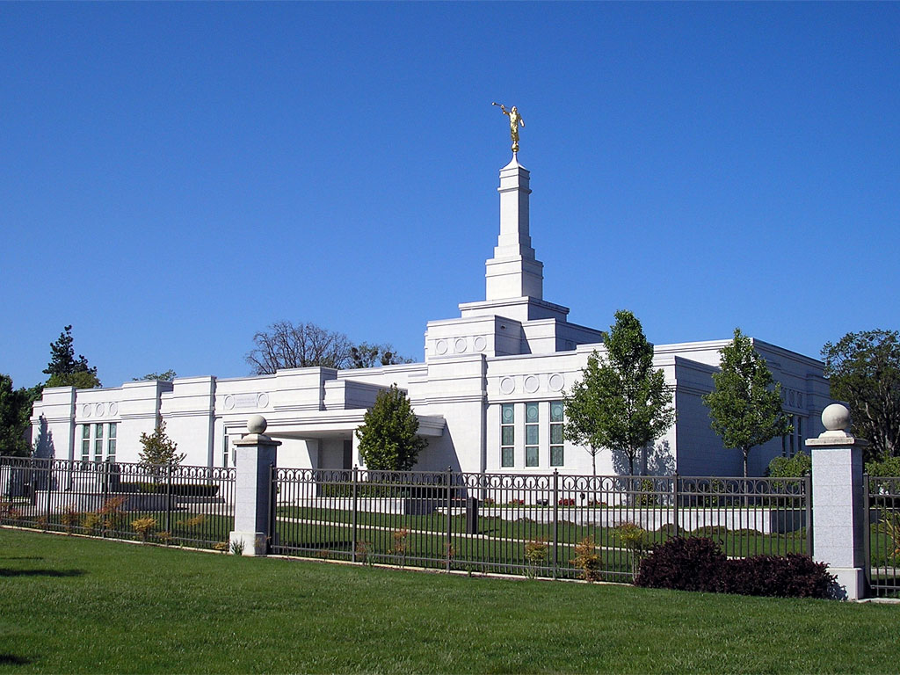

Slide 5
The Scriptures come to life when we know the Power of God
Pharisees | Sadducees
A lay movement (not priests) | Mostly priestly families (Sanhedrin)
Believed in Angels | Didn’t believe in Angels
Believed in the resurrection | Didn’t believe in the resurrection
All of the Hebrew Scriptures (and more) was authoritative | Only the Book of the Law (Pentateuch) (first 5 books of the Bible) was authoritative
The Sadducees didn’t like Jesus because of His belief in the resurrection

Slide 6
^{Deuteronomy 25:5} “If brothers dwell together, and one of them dies and has no son, the wife of the dead man shall not be married outside the family to a stranger. Her husband’s brother shall go in to her and take her as his wife and perform the duty of a husband’s brother to her. ⁶ And the first son whom she bears shall succeed to the name of his dead brother, that his name may not be blotted out of Israel.

Slide 7
⁷ And if the man does not wish to take his brother’s wife, then his brother’s wife shall go up to the gate to the elders and say, ‘My husband’s brother refuses to perpetuate his brother’s name in Israel; he will not perform the duty of a husband’s brother to me.’ ⁸ Then the elders of his city shall call him and speak to him, and if he persists, saying, ‘I do not wish to take her,’ ⁹ then his brother’s wife shall go up to him in the presence of the elders and pull his sandal off his foot and spit in his face. And she shall answer and say, ‘So shall it be done to the man who does not build up his brother’s house.’ ¹⁰ And the name of his house shall be called in Israel, ‘The house of him who had his sandal pulled off.’

Slide 8
The Scriptures come to life when we know the Power of God
The Sadducees didn’t like Jesus because of His belief in the resurrection
Jesus said “You’re very wrong”. In some matters, there is no debate.
They didn’t know the Scriptures
They didn’t know the Power of God
¹⁹ “Teacher, Moses wrote for us that if a man’s brother dies and leaves a wife, but leaves no child, the man must take the widow and raise up offspring for his brother. ²⁰ There were seven brothers; the first took a wife, and when he died left no offspring. ²¹ And the second took her, and died, leaving no offspring. And the third likewise. ²² And the seven left no offspring. Last of all the woman also died. ²³ In the resurrection, when they rise again, whose wife will she be? For the seven had her as wife.”

Slide 9
The Scriptures come to life when we know the Power of God
The Sadducees didn’t like Jesus because of His belief in the resurrection
Jesus said “You’re very wrong”. In some matters, there is no debate.
1. They didn’t know the Scriptures
Some people won’t read whole sections of the Bible
Many filter what the Bible says so it lines up with what they already believe
What we read in The Scriptures should shape what we believe.
What we believe isn’t supposed to shape what we read in the Scriptures
2. They didn’t know the Power of God
Without knowledge of the Power of God, the Scriptures are little more than fairy-tales / fables / moral guidance...
With knowledge of the Power of God, reveals the Gospel worth dying for.
It takes the Power of God to raise the dead
Resurrected life isn’t the same as present life. It’s better, but different.
Christ – central to our worship and adoration

